Slide 1
Ubc department of medicine
Strategic planning
Site Visits
September / October 2022
Strategy + Decision Support

Slide 2
agenda
Introductions & Welcoming Remarks 10 min
Strategic Planning Project Overview & Approach 10 min
Situation Assessment insights 15 min
Draft Vision, Mission and Values 10 min
Draft Success Statements & Operating Principles 15 min
Group Discussion 55 min
Next Steps 5 min
Notes:
Thanking them in advance for their input and participation and recognize the investment of time when we are busy with different priorities. E.g. “I know it is not easy to dedicate time in your already committed schedules, particularly over this past year with extra pressures created and exacerbated by the COVID-19 pandemic, so please know how much I appreciate your participation and commitment to this process”.
Connecting their feedback to building the foundation for the strategic plan and how there are other factors such as prioritization that play a role on the final direction/outcome of the strategic plan
Recognize our role but also the role that other stakeholders play so we do not always have control over the outcomes
Recognition that their voices are important, it would take all of us as a collective community to build our future. We need all of us to move forward!
Emphasize that this plan does not contain all the extraordinary work and projects that are underway or planned in our Department
Emphasize that this is meant to capture the new strategic actions that will guide our next 5 years, recognizing this is a living evolving plan as we move forward.
Emphasize that we will need to remain agile and evolve to the changing nature of the future ahead, the DoM Strategic Plan will provide a roadmap to guide our activities and a set of metrics where we can hold ourselves accountable. We will look to this plan for guidance to remind us of what our priorities are in terms of who we are, what we do and where we are headed.

Slide 3
Our commitment
“We are committed to ensuring the success of our learner and faculty and contributing to the health in the Province of British Columbia”
Anita Palepu
Professor and Eric W. Hamber Chair
Head, Department of Medicine
University of British Columbia

Slide 4
Planning process, timeline and proposed engagement
HERE
PHASE 0
Project Planning
Feb - Apr
PHASE 1
Situation Assessment
Apr – Jun 15
PHASE 2
Strategy Development
Jun 15 – Oct 1
PHASE 3
Activation
Oct 1 – Dec 20
PHASE 4
Implementation & Sustainment
Stakeholder engagement plan & tools (e.g. survey, website)
Project Plan
Working group membership
Peer scan results
Insights from relevant department artifacts and research
SWOT
Draft strategic framework (mission, vision, values, goals and metrics) integrated with Division’s and University’s priorities
Finalized strategic framework
Prioritization of goals
Actions supporting goals
Plan narrative, communication and implementation tools
Year 1 action plan with clear deliverables and accountabilities
Measurement plan
Launch of plan and messaging
Annual reprioritization
Plan Outputs
Website page - updated planning process, timeline, upcoming events
Surveys - launched through email and website
Town hall sessions at Distributed Sites
Targeted interviews with FOM leadership and key external partners
Learners Town Hall
Faculty, staff and learner town halls soliciting input on draft strategic framework
Website page - updated to solicit broad feedback on draft strategic framework
In-person validation with Advisory Committee, FOM leadership and other key stakeholders
Faculty, staff and learner town halls/retreat to validate components of strategic framework
Road shows for validation and information sharing
In-person validation with Advisory Committee
Website page - updated with strategic plan and launch communication
Broad communication/ validation of strategic plan (e.g. Road shows, email, Faculty meetings, etc.)
Engagement Tools
Notes:
There are fives phases, each has specific outputs and specific engagement activities
Timing – started planning in Feb and aiming to launch in December
Brief overview of each stage

Slide 5
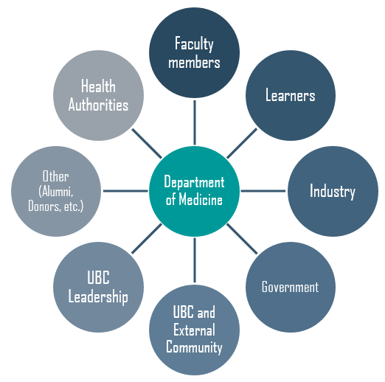
Department of Medicine’s Stakeholder groups
Patients & Community
“Engagement with a broad range of stakeholders throughout the process is a key success factor”
Patients & Community
Patients & Community
Patients & Community
Notes:
Developed stakeholder engagement strategy that will consist of broad consultation across many groups throughout the planning process.
We are using a number of engagement tools to reach as many stakeholders as possible. For example, surveys, townhalls, interviews, focus groups and soliciting feedback through the website
All stakeholders playing a key part in ensuring the patients are our focus

Slide 6
Engagement recap
Surveys distributed to 1,948 faculty, staff and learners
Eight (8) Interviews with selected external partners
Six (6) Spring Site Visits– to Prince George, Kelowna, Vancouver, Victoria, Royal Columbian Hospital, Surrey Memorial Hospital
Two (2) Town Halls – Virtual Learner Town Hall and Virtual Town Hall open to all sites (VFMP, NMP, SMP, IMP)
Four (4) Working Group Meetings
Engagement with ~35 Advisory Committee Members
Notes:
LIST: UBC DOM Academic Faculty (Mar 2022) = 171 members
LIST: UBC DOM Clinical Faculty (Mar 2022) = 821 members
LIST: UBC DOM Staff Only (Mar 2022) = 319 members
LIST: UBC DOM Medical Students (Sept 2021) = 293 members
LIST: UBC DOM Core and Subspecialty Residents (Sept 2021) = 344 members

Slide 7
Fall Engagement
Prince George - Completed
Kelowna - Completed
Vancouver - Completed
Surrey Memorial Hospital – Completed
Virtual Town Hall open to all sites (VFMP, NMP, SMP, IMP) – Completed
Learner Virtual Town Hall – Completed
Royal Columbian Hospital - Completed
Victoria - In Progress
Notes:
LIST: UBC DOM Academic Faculty (Mar 2022) = 171 members
LIST: UBC DOM Clinical Faculty (Mar 2022) = 821 members
LIST: UBC DOM Staff Only (Mar 2022) = 319 members
LIST: UBC DOM Medical Students (Sept 2021) = 293 members
LIST: UBC DOM Core and Subspecialty Residents (Sept 2021) = 344 members

Slide 8
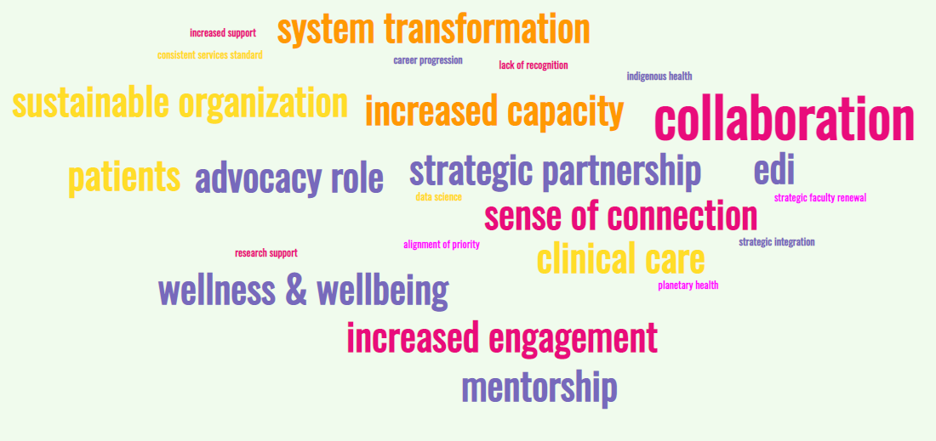
Situation assessment Insights

Slide 9
Southern Medical Program Sites
Island Medical Program Sites
Northern Medical Program Sites
W rking
Vancouver Fraser Medical Program Sites
Together
For : A transformative and inclusive learning health system

Slide 10
Strategic plan framework and components
2. Stakeholder needs
3. Strategic Framework
Vision
Mission
Core Areas + Goals
Actions
Where we want to go, our north star
1. Situation Assessment
4. Validation
Who we are + value we provide
5. Plan Communication
What we want to do to get there
How we are going to do it
Values
Operating Principles
Metrics
Notes:
We will be working on developing this framework together
Values define cultural aspect and support decision making as well
Themes permeate all aspects
Metrics support on accountability
This is an iterative process, It is something that we continue to refine and adjust as the environment changes. Stakeholder needs may change which need to be reflected in strategic framework updates

Slide 11
Questions for discussion
As you go through the following statements, please consider:
What resonates the most with you?
To what extent do you see your role and the role of your group reflected through the vision, mission, and values?
Do the success statements set the right strategic direction for each core area for the coming five years?
Is this the right level of ambition for a 5-year plan?

Slide 12
Draft framework for discussion – Vision Statement
Draft Vision Statement
A transformative and inclusive learning health system
Draft Mission Statement
Through collaborative partnerships and advocacy, we advance education and research to enable the highest quality clinical care for our patients and community throughout BC

Slide 13
updated value statements
Compassion
We show kindness and empathy toward each other and ourselves and are genuinely concerned with the wellbeing of all members. We approach our work with humility, ultimately respecting the dignity, individuality and needs of learners, patients, and community.
Excellence
We strive to be outstanding at all that we do by continuously exploring, learning, innovating and adapting. We value the contributions from all of our members and support them to be their very best selves.
Inclusivity
We are committed to promoting a welcoming and equal opportunity environment where individuals of all life experiences, identities, ancestries and roles feel heard, valued and empowered
Integrity
We are accountable to ourselves and each other for upholding the highest standards in our work and our relationships; decisions are evidence-based and actions are grounded in transparency, honesty, and mutual respect.

Slide 14
Core areas, success statements and operating principles definitions
Operating Principles: Written statements that describe how group members will operate; they create an organization-wide focus and awareness of what the long-term, “big picture” objectives are for the organization.
Core areas delineate our major streams of activity. Each core area has a corresponding success statement. These aspirational statements articulate what success will look like for these areas in the future; they are “mini” vision statements for each core area with corresponding strategic goals which will direct the work of the Department of Medicine over the coming years.​

Slide 15
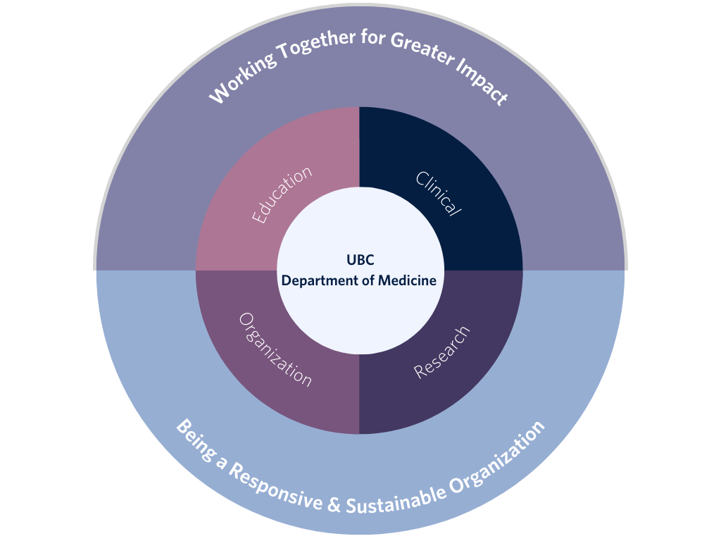
Core areas and operating principles

Slide 16
DRAFT operating principles
Principle | How we apply it
Working Together For Greater Impact | We are committed to harmonizing our efforts across sites, regions, and with our partners to transform the learning health system and to create inter-organizational communities. By developing and maintaining mutually beneficial relationships and collaborations with our patients, health partners and our community, we enhance learning outcomes, advance research excellence, improve clinical care, and ignite a collective effort to achieve positive province-wide impact for the health of British Columbians.
Being a Responsive and Sustainable Organization | We build flexibility and sustainability in our processes and systems so that we can respond effectively to evolving health needs. We carefully align resources with strategic priorities in scholarship, practice and health outcomes. By embedding sustainable practices throughout our organization, we demonstrate our commitment to making a positive impact towards wellbeing and planetary health.
Notes:
Ha

Slide 17
DRAFT SUCCESS STATEMENTS - organization
We work together to:
promote a safe, respectful and inclusive learning and working environment;
support our members in achieving their fullest potential while focusing on their well-being; through an inclusive and organizational culture and structure;
recognize the meaningful contributions of our faculty, staff, and learners;
adapt virtual and digital technologies to meet the needs of our health populations;
ensure our policies, processes and methods are in alignment across teams, divisions, and distributed sites;
advocate for increased resources and collectively identify Department-wide priorities for a more effective distribution of funds and resources;
co-identify opportunities and implement solutions with our partners and community to build capacity across the learning health system; and
reduce the negative environmental impacts of our work.

Slide 18
DRAFT SUCCESS STATEMENTS - education
We work together to:
instill a culture of continuous learning and provide support and effective tools that prepare current and future health practitioners, educators and researchers to collectively serve the evolving health needs of our community;
continuously identify emerging needs, expand and renew our innovative education programs, optimize learning outcomes and enable interdisciplinary and interprofessional learning; and
attract a diverse group of applicants and provide a rich learning experience through our unique distributed model, strong teaching faculty and renowned educational programs.
Notes:
Programming and overall learning opportunities
Mentorship and PD for educators so they are very effective
Health system needs in terms of education - Advocacy role in terms of seats needed etc
Attracting excellent applicants
Encouraging continuous education

Slide 19
DRAFT SUCCESS STATEMENTS - research
We work together to:
provide an dynamic environment that enables research activities across the continuum from discovery to translational research;
reduce barriers to research progress, and enable a culture of collaboration and continuous improvement;
strategically allocate resources to focus on the areas that increase our excellence in scholarship and research outcomes;
address big questions of local and global relevance in health education and research, healthcare needs, and patient outcomes; and
be recognized for global excellence in academic research, supported by outstanding faculty and staff, and strong partnerships with affiliated research institutes, centres, community partners, and units across UBC.

Slide 20
DRAFT SUCCESS STATEMENTS - CLINICAL
We work together to:
provide leadership in transforming the health system and adapt our structures and processes to effectively respond to ongoing changes in healthcare delivery and access to care;
deliver the highest-quality team-based medical care in our training programs as a critical component of the health care delivery system of our province;
inform what quality care means at every level of the system by meaningfully involving patient advocacy groups, patients and the community and take actions to improve it;
promote a culture of continuous improvement.
Notes:
Might be missing: Culture of quality improvement and Leadership/advocacy? role in ensuring there are enough residents to provide better patient care? Engage in care transformation in the health system and support primary care

Slide 21
Group discussion
What resonates the most with you?
To what extent do you see your role and the role of your group reflected through the vision, mission, and values?
Do the success statements set the right strategic direction for each core area for the coming five years?
Is this the right level of ambition for a 5-year plan?

Slide 22
How can you continue to participate?
Check out the updates in the website https://medicine.med.ubc.ca/strategic-plan-2023-2027/
Provide your thoughts on the draft strategic framework through the comments section in the website
Celebrate the progress made and help us spread the word!
This is a project that will need input from our entire community! Together we can determine how we want the Department of Medicine to be in the next few years.
Notes:
Note: we will consolidate all of the feedback received from the site visits and post it on the website for you to review

Slide 23
Next steps for phase 3
Complete next round of site visits and town halls to collect feedback on the initial strategic plan draft
Continue working on goals, actions, metrics and prioritization.

Slide 25
Core areas and operating principles
Organization
Education
Research
Clinical
Working Together For Greater Impact
Being a Responsive and Sustainable Organization

